Slide 1


Unit 3: Culture spot 3 What to eat in the UK?

Slide 2


Slide 3

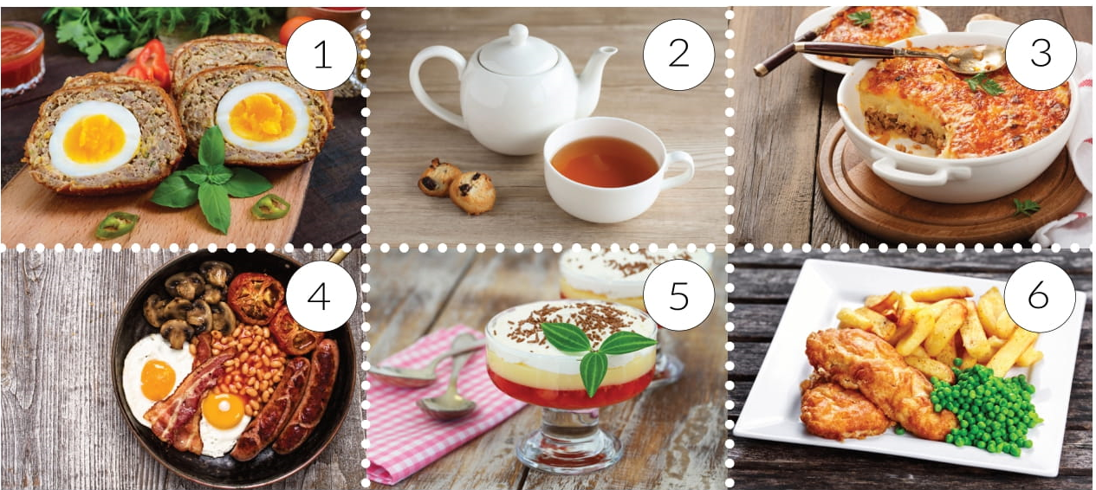
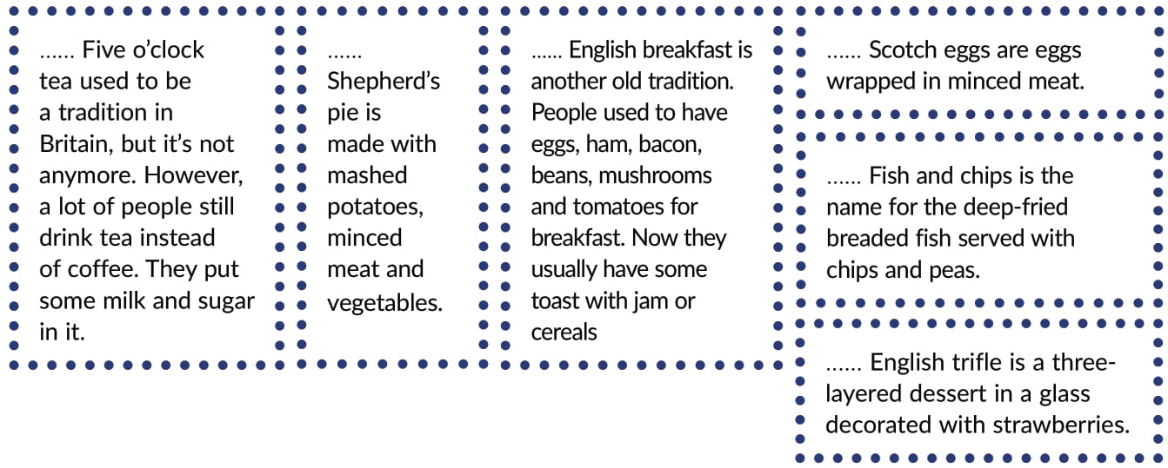
2
3
4
1
6
5

Slide 4
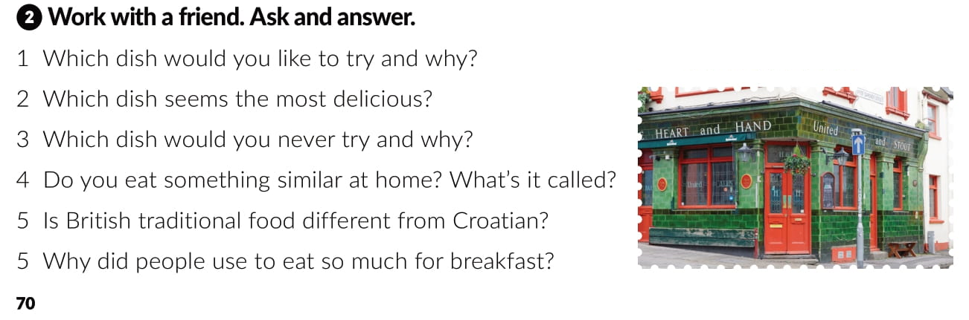

Slide 5
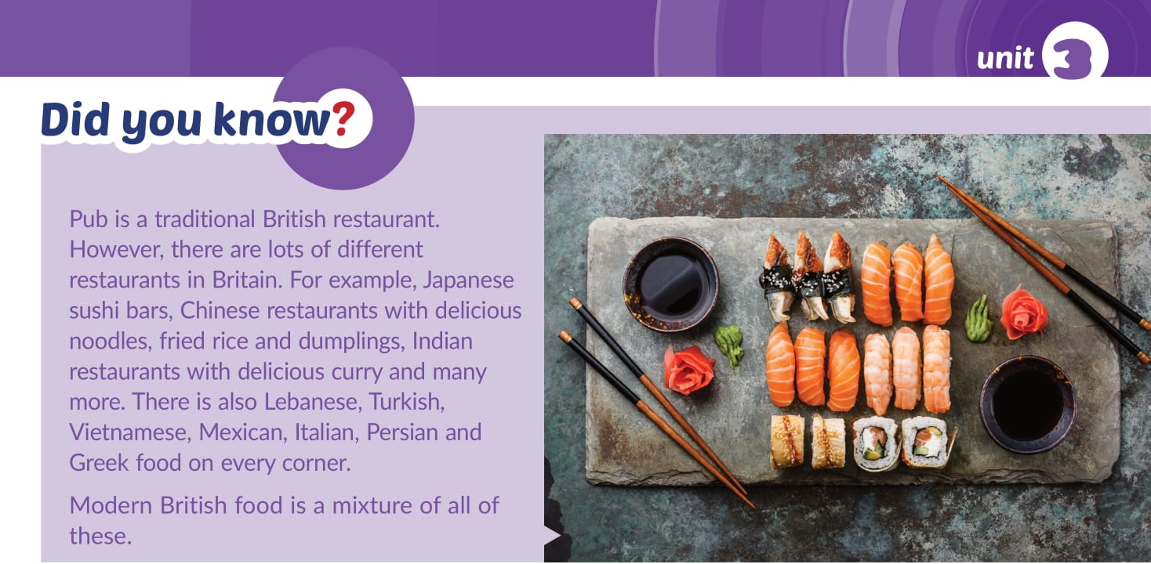

Slide 6
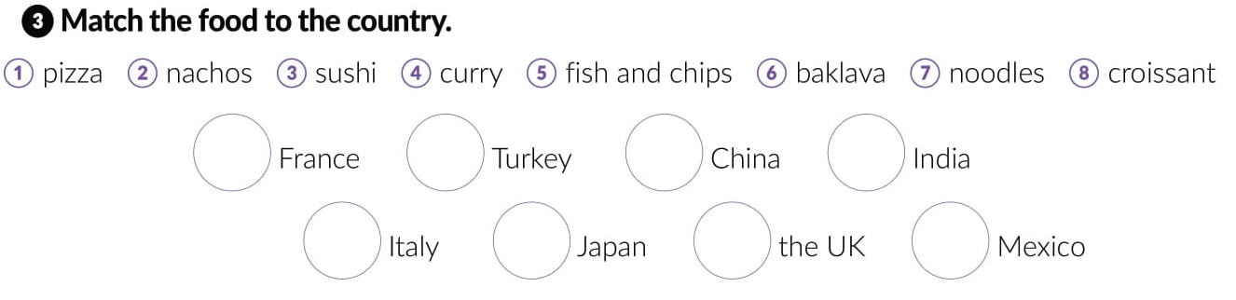
8
6
7
4
1
3
5
2

Slide 7

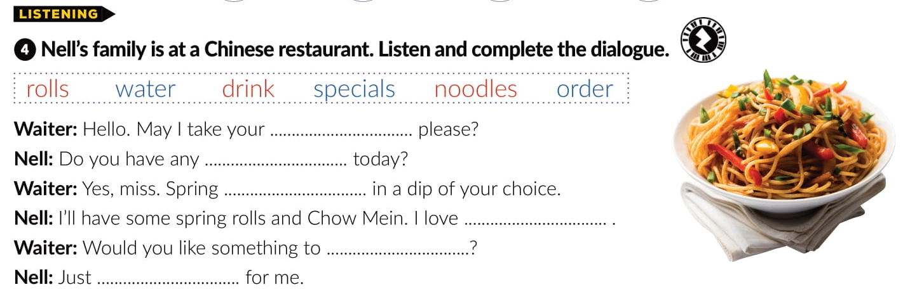
order
specials
rolls
noodles
drink
water

Slide 8
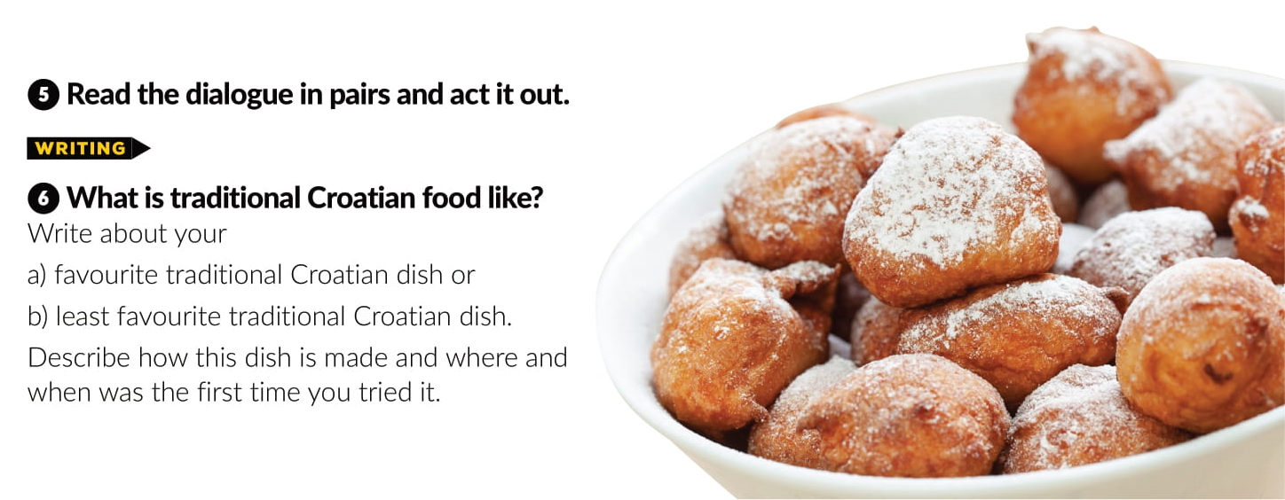

Slide 9
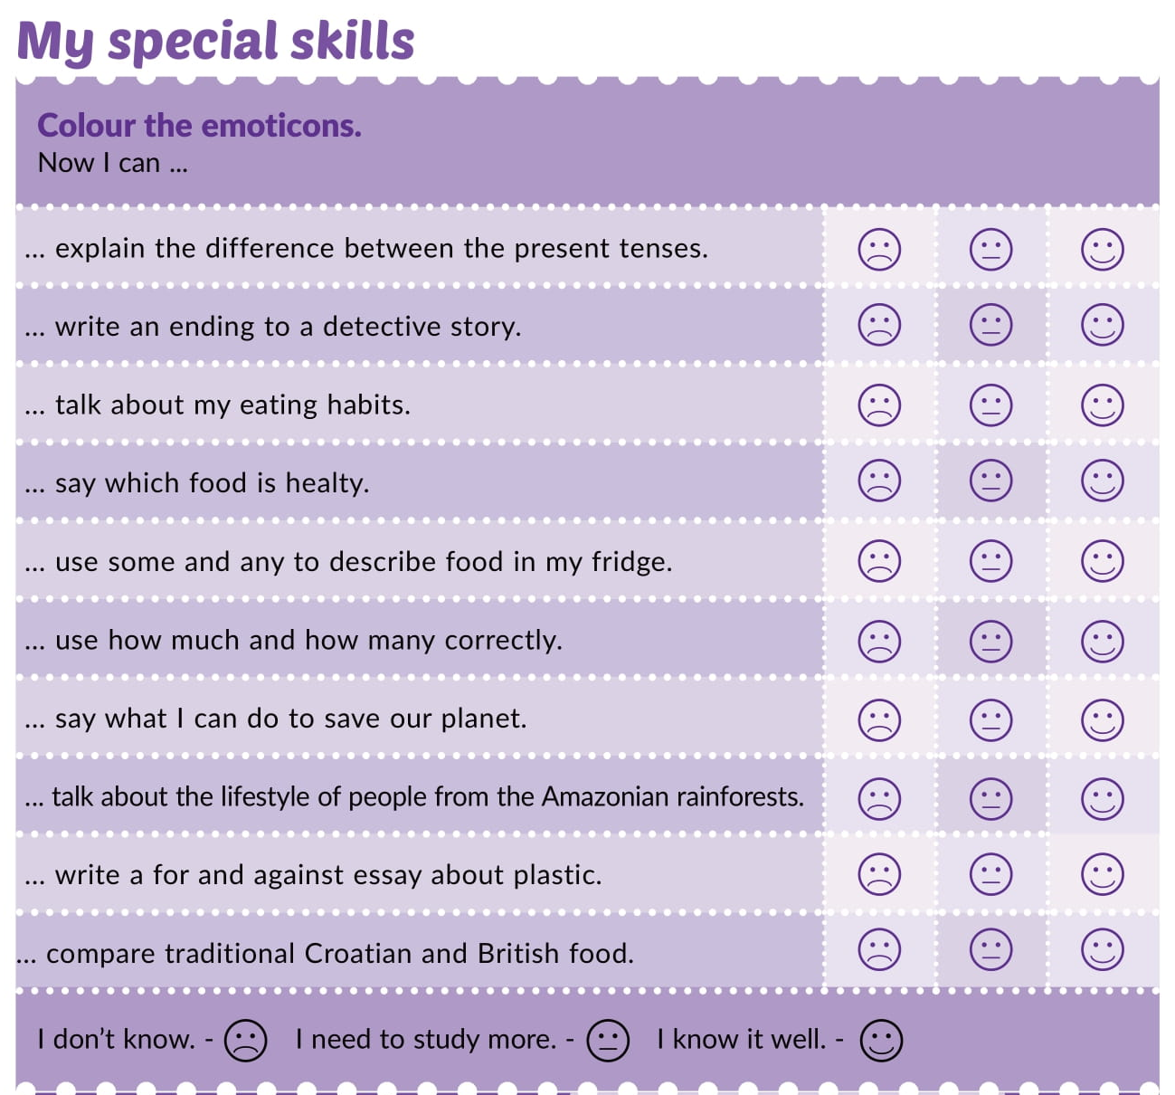

Slide 10


Slide 11
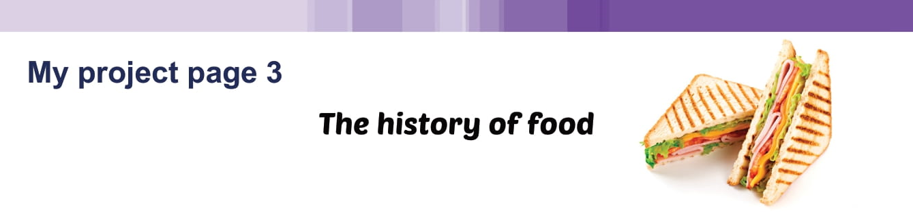
Workbook page 56

Slide 12
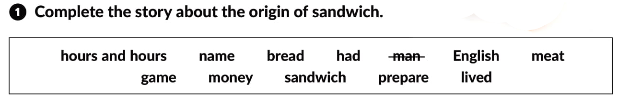
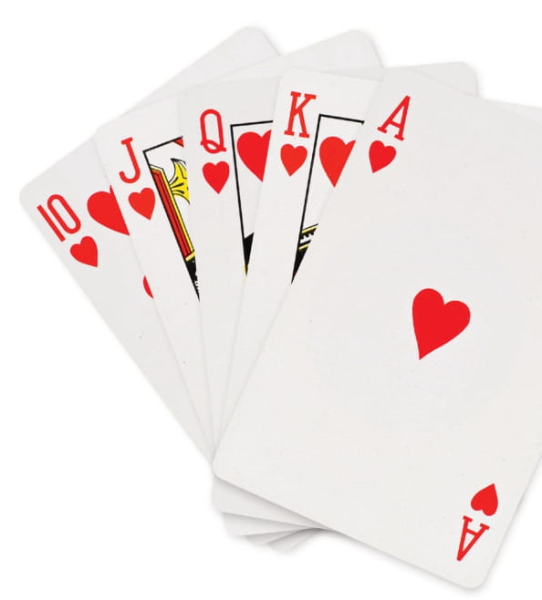
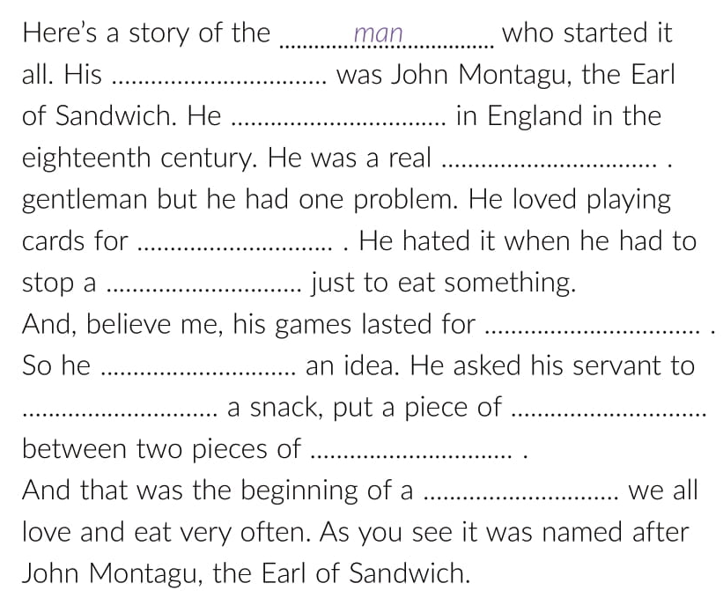
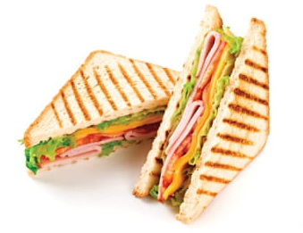
name
lived
English
money
game
hours and hours
money
prepare
meat
bread
sandwich

Slide 13
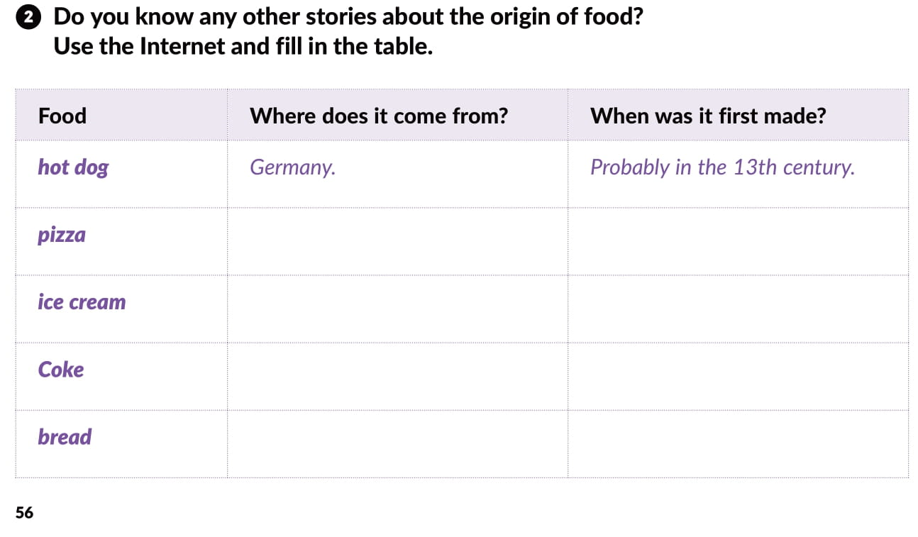
Italy
Modern pizza in the 18th century
Roman Empire or China
1st century or 16th century
USA
19th century
The Middle East
8 000 years ago

Slide 14

PLAY AND LEARN
Culture spot 3 | Way to go 3 (e-sfera.hr)

